Slide 1
Data Analysis as Statistical Learning
Chapter 1
Built from L1 slides 2-12 and L2 slides 2-8

Slide 2
Welcome to Data Analysis
Statistical modeling (statistical learning) class
Bridges what you learned in OA3101/3102
Tools for advanced methods leading to Machine Learning (OA4106/4118)

Slide 3
Data?
What is data?
Examples?
Input vs Output (response) variables
$$Y=f(x)=β_{0}+β_{1}x_{1}+β_{2}x_{2}$$
$$Y=f(x)=β_{0}+β_{1}x_{1}+β_{2}x_{2}+ε$$
Notes:
1. Data
You can point to each piece:
$x_{1},x_{2}$: observed inputs
$Y$: observed output
$ε$: unobserved noise
Then ask:
“Which of these do we actually get to see? Which do we never see?”
This immediately grounds the course in the reality of data work.

Slide 4
Inference vs Prediction
So far we’ve probably done a lot with inference
Given input variables/parameters, what can we say about certain parameters and their effect on the output?
Examples?
$$Y=f(x)=β_{0}+β_{1}x_{1}+β_{2}x_{2}+ε$$
Notes:
2. Inference
Inference is about the parameters:
What is $β_{1}$?
What is $β_{2}$?
Are they positive? Negative? Zero?
How certain are we?
What assumptions do we need?
You can say:
“Inference is about learning the structure of the world.”
This is the OA3102 → OA3103 bridge.

Slide 5
Prediction
Given input variables, what can we expect the output variable to be?
Examples?
$$Y=f(x)=β_{0}+β_{1}x_{1}+β_{2}x_{2}+ε$$
Notes:
3. Prediction
Prediction is about the output:
Given new $x_{1},x_{2}$, what do we expect $Y$to be?
How accurate can we be?
How much uncertainty remains?
What happens when the model is wrong?
You can say:
“Prediction is about learning what will happen next.”
This is the OA3103 → OA4106 bridge.

Slide 6
Regression and Classification
Regression
Classification
$$y$$
$$x_{2}$$
$$y$$
$$0 1$$
$$x$$
$$x_{1}$$
Source: An Intro to Spectral Convolution Neural Networks by Dr. Patrick McClure

Slide 7
Model: Linear
Regression
Linear Regression Model
Classification
Logistic Regression Model
$$y$$
$$x_{2}$$
$$y$$
$$0 1$$
$$x$$
$$x_{1}$$
$$p\left(y=1 | x\right)=sigmoid\left({w_{1}x}_{1}+{w_{2}x}_{2}+b\right)=\frac{1}{1+e^{{w_{1}x}_{1}+{w_{2}x}_{2}+b}}$$
$$\hat{y}=wx+b$$
Source: An Intro to Spectral Convolution Neural Networks by Dr. Patrick McClure

Slide 8
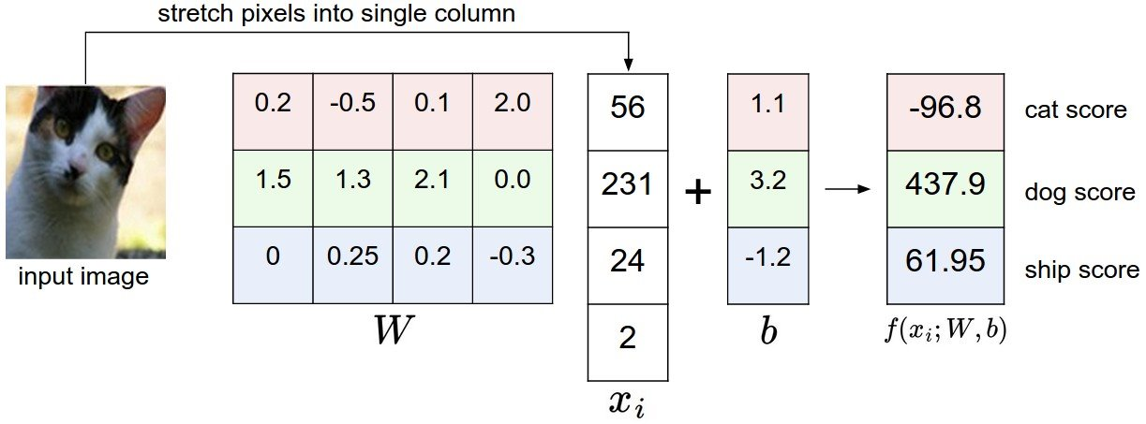

Model: Linear Classification
cat logit
dog logit
ship logit
Source: An Intro to Spectral Convolution Neural Networks by Dr. Patrick McClure

Slide 9
Data: Non-linear
Regression
Classification
$$y$$
$$x_{2}$$
$$y$$
$$0 1$$
$$x$$
$$x_{1}$$
Source: An Intro to Spectral Convolution Neural Networks by Dr. Patrick McClure

Slide 10
Model: Non-linear
Regression
Classification
$$y$$
$$x_{2}$$
$$y$$
$$0 1$$
$$x$$
$$x_{1}$$
$$p(y=1|x)=\frac{1}{1+e^{w{(x_{1}−h)}^{2}+w{(x_{2}−k)}^{2}+b}}$$
$$\hat{y}=w{(x−a)}^{2}+b$$
Source: An Intro to Spectral Convolution Neural Networks by Dr. Patrick McClure

Slide 11
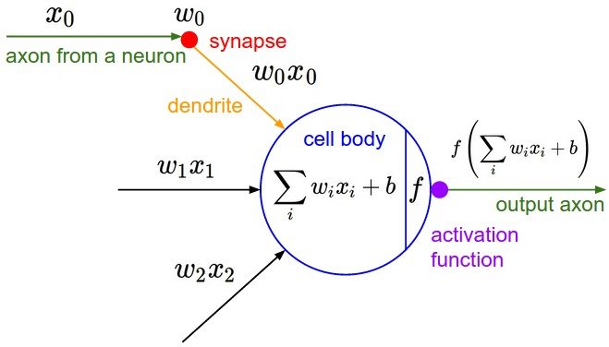
Model: Fully-connected Neural Network Layer
0
$$σ($$
$$)$$
Non-Linearity
Source: An Intro to Spectral Convolution Neural Networks by Dr. Patrick McClure

Slide 12
Reproducibility and Defensibility
Reproducibility (What we do):
Same code + Same data = same results
Clear workflow
Document our assumptions, transformations, and decisions
Your future self (and others) should be able to rerun the analysis without guessing
Defensibility (What we explain):
To our customer / Commander
Why this model?
What assumptions does our method rely on?
What alternatives did we consider?

Slide 13
Using Math to Prove or Explain Real Phenomena
Today we will quantify the phrase:
“All models are wrong.”
First, we will review the statistical concepts from yesterday.

Slide 14
Review of Statistical Concepts
Expectation: (Intuitively) The weighted average of all possible outcomes.
For Random Variables $X,Y$ and constants $a,b:$
$$𝔼\left[aX+b\right]=a𝔼\left[x\right]+b$$
Linearity of expectation:
$$𝔼\left[X+Y\right]=𝔼\left[X\right]+𝔼[Y]$$
regardless of independence between $X$ and $Y$.

Slide 15
Review of Statistical Concepts
Variance: (Intuitively) The weighted average of the squared deviations from the mean.
Calculating variance:
$$Var\left[X\right]=𝔼\left[X^{2}\right]−{\left(𝔼\left[X\right]\right)}^{2}$$
Rules:
$$Var\left[aX+b\right]=a^{2}Var[X]$$
and
$$Var\left[X+Y\right]=Var\left[X\right]+Var\left[Y\right]+2Cov(X,Y)$$
If $X⊥Y$ (they are independent), then $Cov\left(X,Y\right)=0$.
But not necessarily true in the other direction!

Slide 16
Review of Statistical Concepts
Covariance: The weighted average of the product of deviations of $X$ and $Y$. For respective true means $μ_{X}$ and $μ_{Y}$:
$$Cov\left(X,Y\right)=𝔼[\left(X−μ_{X}\right)\left(Y−μ_{Y}\right)]$$
Correlation: Scaled covariance into the range $[−1,1]$
$$ρ_{XY}=\frac{Cov\left(X,Y\right)}{\sqrt{Var\left[X\right]⋅Var[Y]}}$$

Slide 17
Review of Statistical Concepts
Finally, we examine bias.
Bias: The difference between the expected value of an estimator $\hat{θ}$ and the true parameter $θ$ it aims to estimate.
$$Bias\left(\hat{θ}\right)=𝔼\left[\hat{θ}\right]−θ.$$
Bias is about systematic error (induced by our measurements or our model choice), not random error.

Slide 18
Statistical Modeling
We model the relationship between output variable $Y$ and input variables $X_{1},X_{2},…,X_{p}$ (as a vector $X$):
$$Y=f\left(X\right)+ε.$$
Assume the following:
$ε$ is a random variable with mean zero, i.e. $𝔼\left[ε\right]=0$,
$Var\left(ε\right)>0$, and
$ε$ is independent of $X$.

Slide 19
Statistical Modeling
We don’t actually know $f(X)$. Therefore, we have to estimate it.
Denote estimated $f$ by $\hat{f}$, and predicted $Y$ by $\hat{Y}$. Then we have
$$\hat{Y}=\hat{f}\left(X\right).$$
The formula $\hat{f}$ is a general statistical model
Reminder:
Prediction: Use input variables $X_{1},X_{2},…, X_{p}$ in our model $\hat{f}$ to estimate $Y.$
Inference: Understand the relationship between $X$ and $Y$.
Which of $X_{1},X_{2},…,X_{p}$ are (most) relevant to $Y$?
How does changing $X_{i}$ for some $i$ in $[1,…,p]$ affect the output $Y$ using our model?

